Slide 1
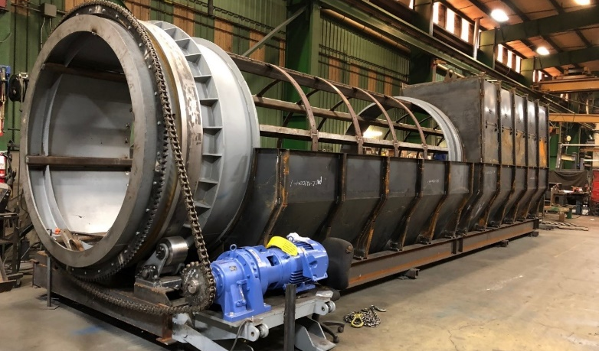
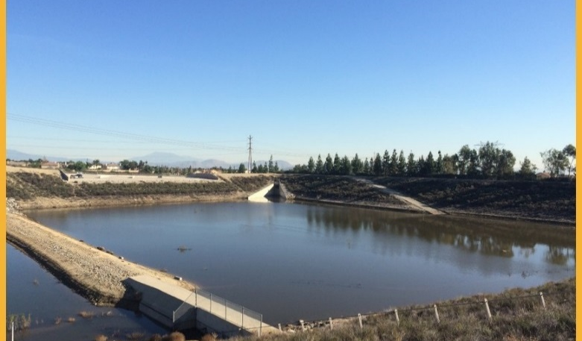
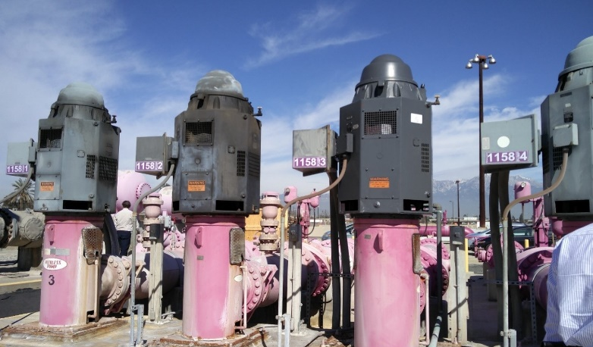
Fiscal Years 2019/20 and 2020/21
Biennial Budget Adoption
Board Meeting
Christina Valencia
June 2019

Slide 2
Key Areas of Focus
Over the Next Two Years
Succession Planning
Cost Containment
Upkeep of Agency Assets
Leverage Low Interest Debt
Transparency
No Changes to Adopted Rates and Fees
Notes:
Succession planning – Over 30 percent of the Agency’s workforce is eligible for retirement over the next five years. Essential to the transfer of knowledge and expertise to the next generation of employees is timely recruitment. Included in the proposed biennial budget is the set-up of an estimated ten-full time equivalent (FTE) succession planning pool for recruitment of critical positions throughout the Agency;
Cost containment – Forecasted operations and maintenance expenses such as chemicals, operating fees, professional fees, and utilities are relatively stable as a result of the Agency’s continuing commitment to cost containment;
Upkeep of Agency assets – Continue the transition from “corrective” to “predictive and preventative” maintenance of Agency assets to ensure regulatory compliance, avoid costly corrective maintenance, and effectively meet the Agency’s commitment to delivering a high quality level of service;
Optimize low interest debt – Continue to secure low cost financing to finance capital expansion and improvement of Agency’s facilities to meet anticipated growth and increased service demands; and
Transparency – Continue to provide a platform for transparent communication and timely reporting.

Slide 3
Proposed TYCIP $921M
Nearly 68% planned over the first five years
Over $325M for Expansion & Recovery
RP-5 Expansion
RP-1 Capacity Recovery
Notes:
$677.1 million approx. 68% planned over first five years

Slide 4
Sources and Uses of Funds
*Other Revenues include state loans, grants, interest revenue, and contract cost reimbursements

Slide 5
Outstanding Debt and
Debt Coverage Ratio (DCR)
FY | 2018/19 | 2019/20 | 2020/21 | 2021/22 | 2022/23 | 2023/24
 | Projected | Biennial Budget |  | Forecast
DCR | 3.92x | 3.65x | 3.68x | 3.78x | 4.57x | 3.50x

Slide 6
Consolidated Fund Reserve
($M)

Slide 7
FY 2019/20 Inter Fund Transfers
($M)
Fund In/(Out) | Capital | Debt Service | Operating | Connection Fee | Net Transfers in/(Out)
Wastewater Capital | $3.40 | ($3.30) | - | ($9.00) | ($8.90)
Wastewater Operations | ($4.60) | $0.30 | ($2.20) | $5.70 | ($0.80)
Recycled Water | ($0.09) | $2.40 | ($0.80) | ($2.00) | ($0.49)
Recharge Water | $0.04 | $0.60 | $0.80 | $0.02 | $1.46
Non-Reclaimable Wastewater | ($0.04) | - | ($0.08) | $2.30 | $2.18
General Administration | $1.30 | - | $2.30 | $1.02 | $4.62
Water Resources | - | - | - | $1.95 | $1.95
Net Transfer | $0.00 | $0.00 | $0.00 | $0.00
Totals may not tie due to rounding

Slide 8
Recycled Water Fund
Inter Fund Loan Repayment Plan
Inter Fund Loans Issued | Due to | Loan Amount ($M) | Repayment Plan
FY 2007/08 | Non-Reclaimable Wastewater (NRW) Fund | $9.0 | 2018/19 $3.0 2020/21-2021/22 $6.0 Total $9.0
FY 2007/08 | Regional Wastewater Capital (RC) Fund | 3.0 | 2022/23 $1.0 2023/24-2024/25 $2.0 Total $3.0
FY 2009/10 | Non-Reclaimable Wastewater (NRW) Fund | 6.0 | 2021/22 $3.0 2022/23 $3.0 Total $6.0
FY 2014/15 | Regional Wastewater Capital Improvement (RC) Fund | 10.5 | 2022/23 $1.0 2023/24 $5.0 2024/25 $4.5 Total $10.5
Total |  | $28.5 | $28.5

Slide 9
RATE RESOLUTIONS
Resolution No. | Description
2019-6-1 | Service Rates and Excessive Strength Charges for Regional or Industrial Wastewater Discharge
2019-6-2 | Service Rates on Capacity, Volumetric, Strength, Capital Improvement, and Application Fees for the Etiwanda Wastewater Line (EWL)
2019-6-3 | Service Rates on Capacity, Volumetric, Strength, and Application Fees for the Non-Reclaimable Wastewater System (NRWS) East End
2019-6-4 | Service Rates on Capacity, Volumetric, Strength, Capital Improvement, and Application Fees for the Inland Empire Brine Line (IEBL)
2019-6-5 | Laboratory Rates
2019-6-6 | Extra-Territorial Sewer Charges
2019-6-7 | Imported Water Rates
2019-6-8 | Equipment Rental Fees

Slide 10
Recommendation
Close the public hearing
Adopt Resolution No. 2019-6-10, approving the Agency’s Biennial Budget for FYs 2019/20 and 2020/21 including:
Adopt FYs 2020-2029 TYCIP
Inter-fund transfers
Agency-wide department goals and objectives
Rate Resolution Nos. 2019-6-1 through 2019-6-8 for the Non-Reclaimable Wastewater System (NRW) fund and other service fees
Inter-fund loan repayments
Regional Committee review and recommendation of any related future third-party agreements
The Biennial Budget is consistent with the Agency’s business goal of fiscal responsibility and prudent financial planning.
Notes:
Recycled Water Projects $19.5M
1299 Pressure Zone Pipeline Capacity Upgrade $9.0M
1630 E. Pipeline Segment B & 1630 E. Reservoir $6.4M
RP-1 Outfall Parallel Line $3.1M
Wineville Basin Pipeline $1.0M

