Slide 1
Garden in Every School®

Slide 2
Program Partners & Sponsors

Slide 3
Garden in Every School® Program Overview
The purpose of the GIES program is to educate children and their families, school staff, and other community members about the efficient use of water through the establishment of thematic school gardens that feature climate appropriate plants and efficient irrigation methods.
Program began in 2004
Installed 60 gardens since inception
$4,500 assisted grant
School representative must attend workshop to be eligible
Approximately four schools per year are selected
Build relationships with schools and introduce water-use efficiency opportunities through new irrigation techniques, low water use plants and state-aligned curriculum
Promote hands-on outdoor learning
Aims to build water-wise educator networks

Slide 4
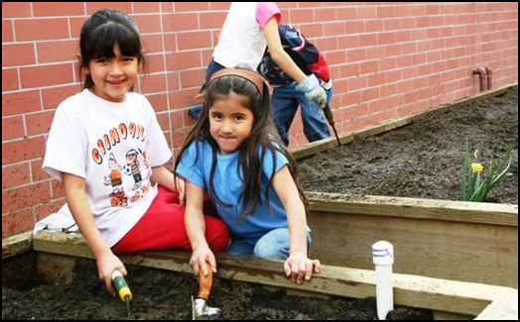
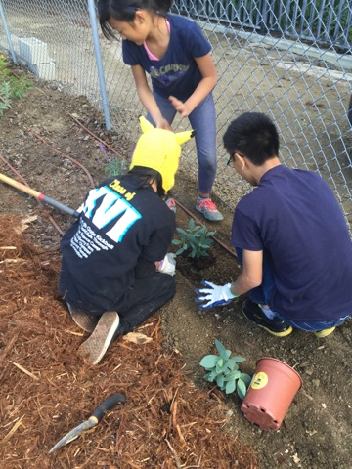
Benefits of School Gardens as Outdoor Classrooms
Encourages wise-water usage.
Underscores good nutritional habits.
Illustrates the web of life.
Celebrates multi-cultural awareness.
Effective with different learning styles (sight, smell, taste and touch).
Increases students’ self-esteem.
Enhances academic instruction.
Builds teamwork.

Slide 5
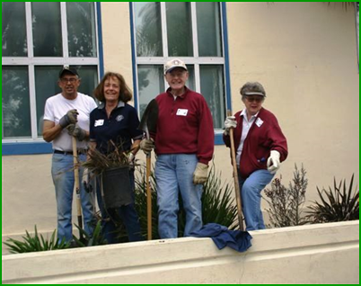
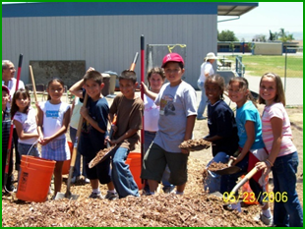
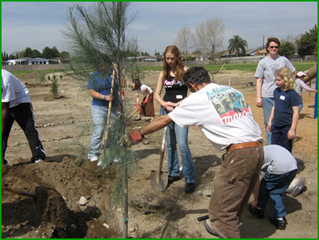
Components of a Successful School Garden
School Staff
Maintenance Team
Students
Parents
Community

Slide 6
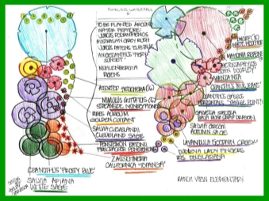
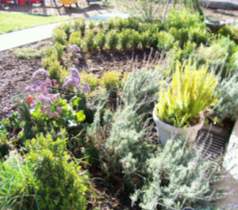
What the Program Includes
$4,500 grant funding
Assistance in the establishment of a theme garden
Site selection
Irrigation installation
Design and installation of the garden (Note: Site clearing is the responsibility of the school and maintenance team)
Funding of climate appropriate plants, vegetables, garden tools, irrigation equipment.
Access to state-aligned curriculum materials promoting the efficient use of water for teachers and parents.
And to showcase your school and stand out as an environmental steward in your community.

Slide 7
What the Program Does Not Include
Site Clearing
Longevity Maintenance
Minimum four year commitment
Additional Labor
Grant funding cannot be used to purchase non-related garden materials including text books, fences, benches, water features, etc.

Slide 8
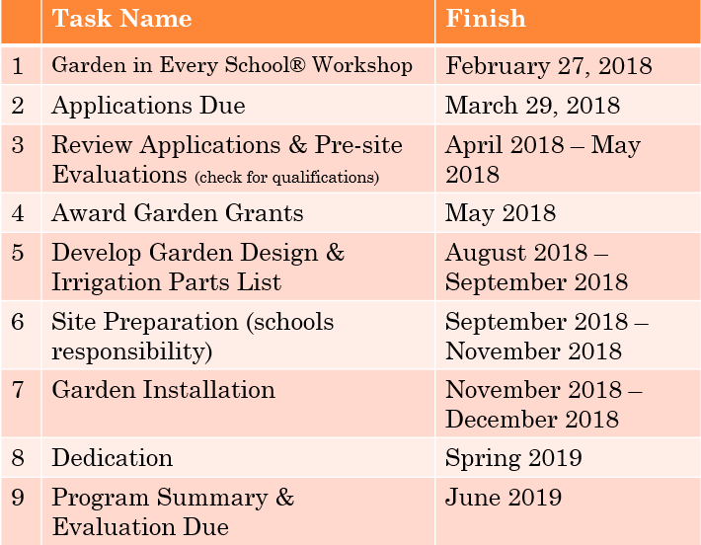
Task List & Schedule

Slide 9
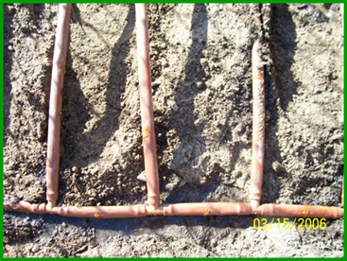
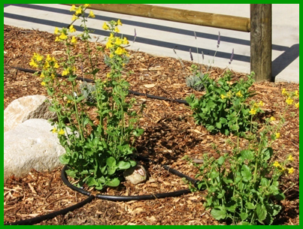
Garden Design Criteria
Efficient Irrigation
Water Connection Hook Up
Water-Wise Plants
Vegetables – Up to 7 Vegetable Beds Maximum
Other Plants & Themes
Wise-Water Usage
Bird and Butterfly
Native Plants
Sustainable Agriculture
Literacy
Sensory
California Regions
Salsa, Mixed Vegetable Salad or Root Vegetables

Slide 10
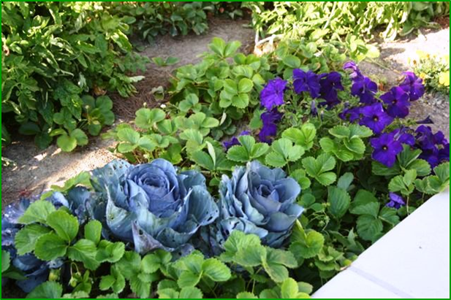
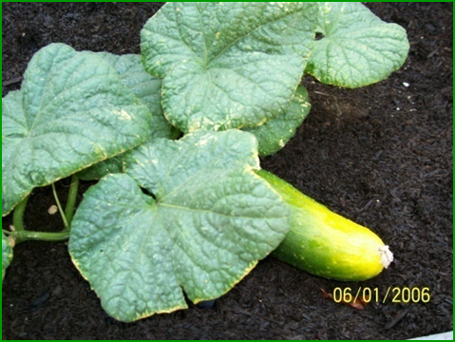
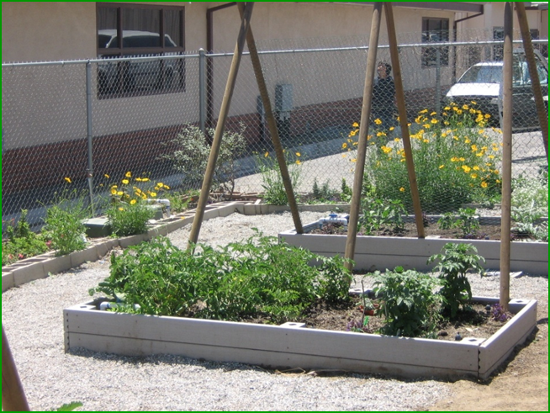
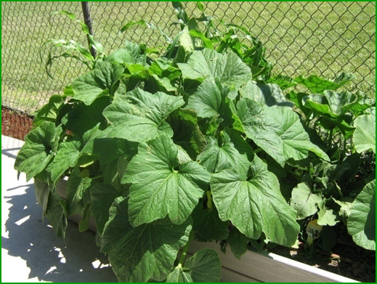
Sustainable Agriculture

Slide 11
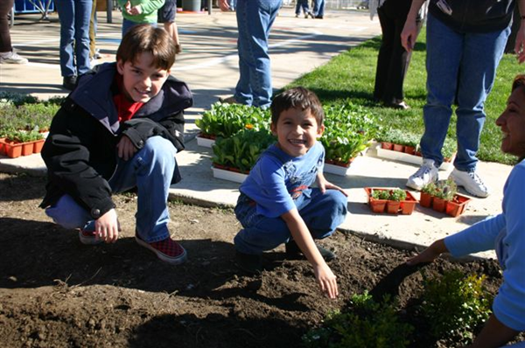
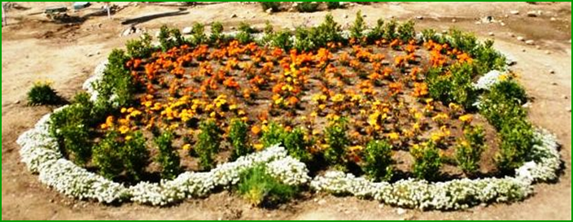
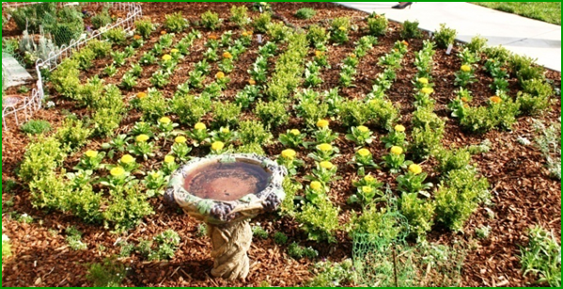
Sensory, Bird & Butterfly

Slide 12
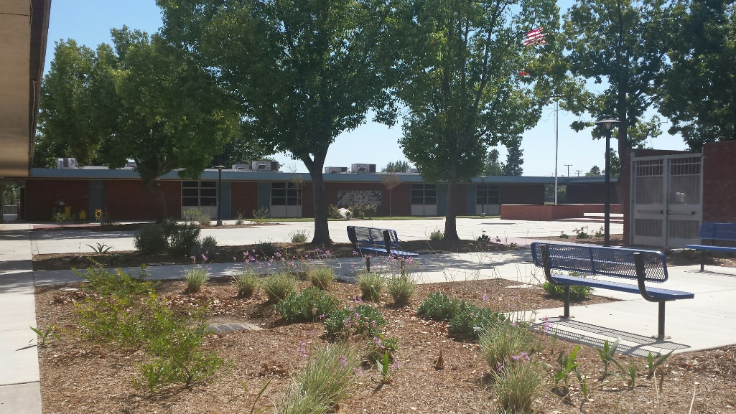
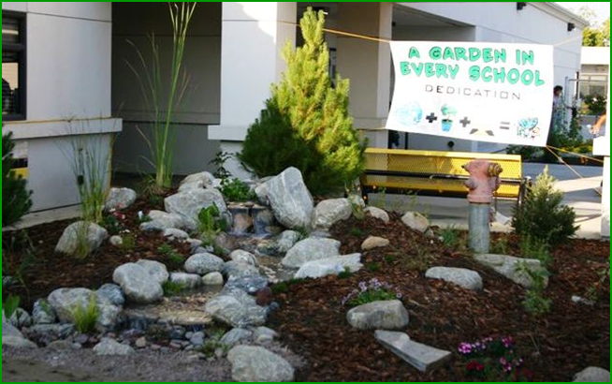
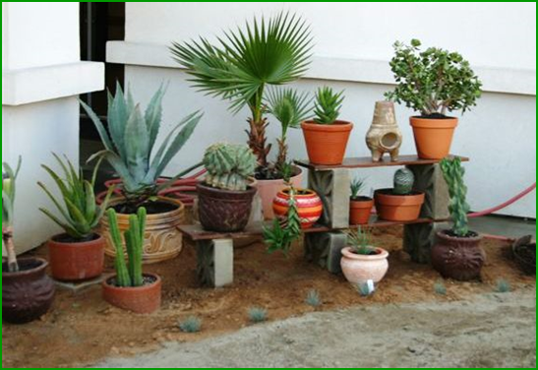
California Regions

Slide 13
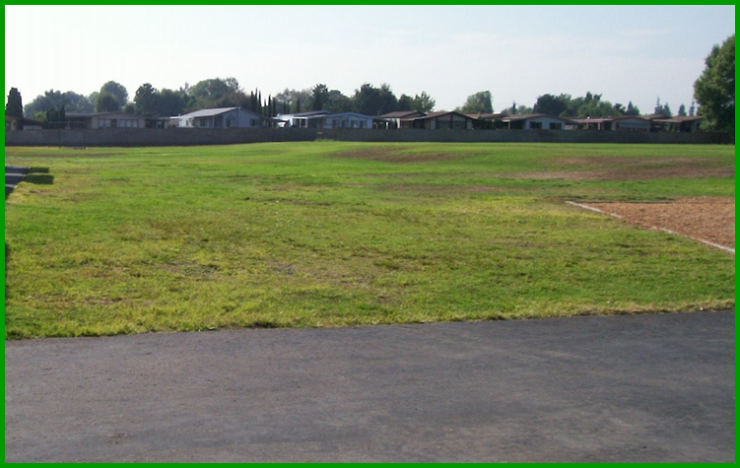
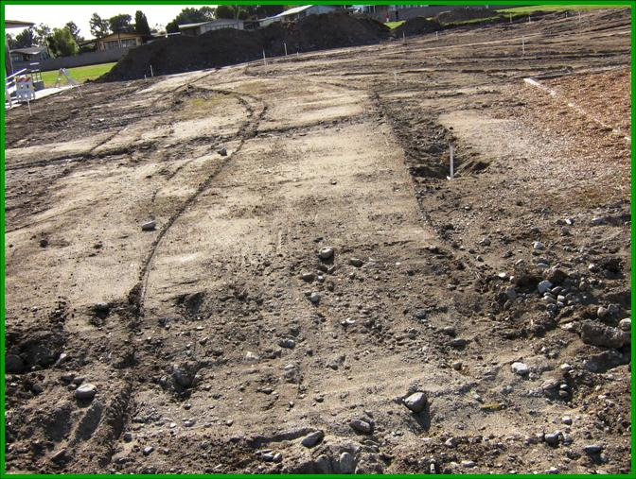
Site Preparations
Turf Removal
Before
After

Slide 14
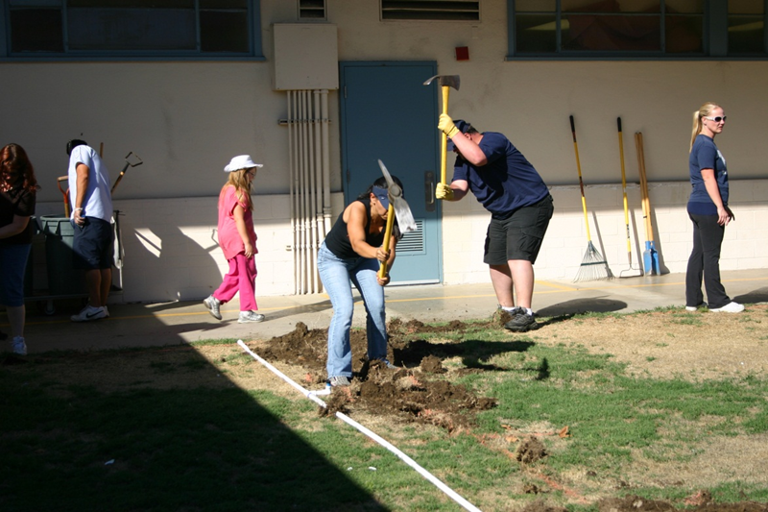
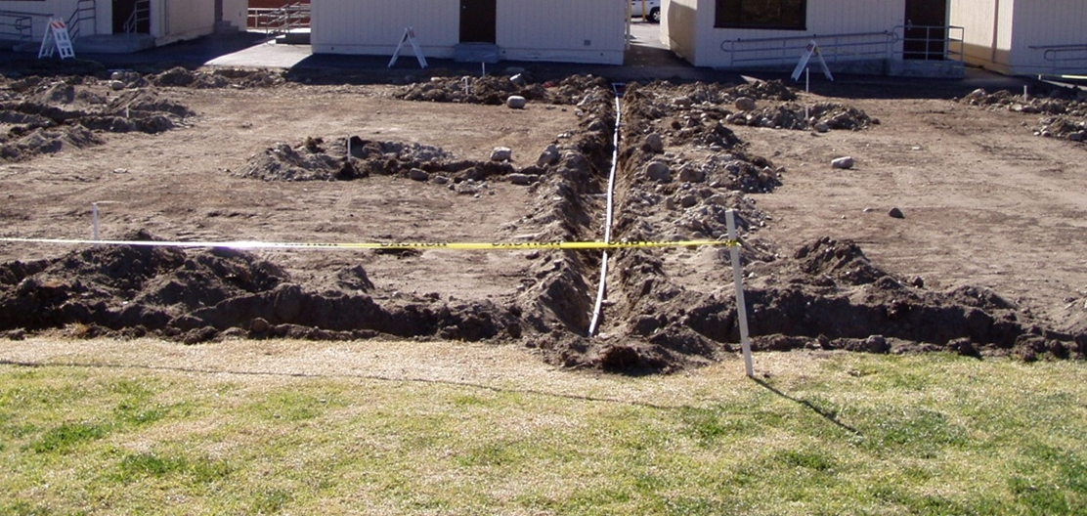
Digging Trenches

Slide 15
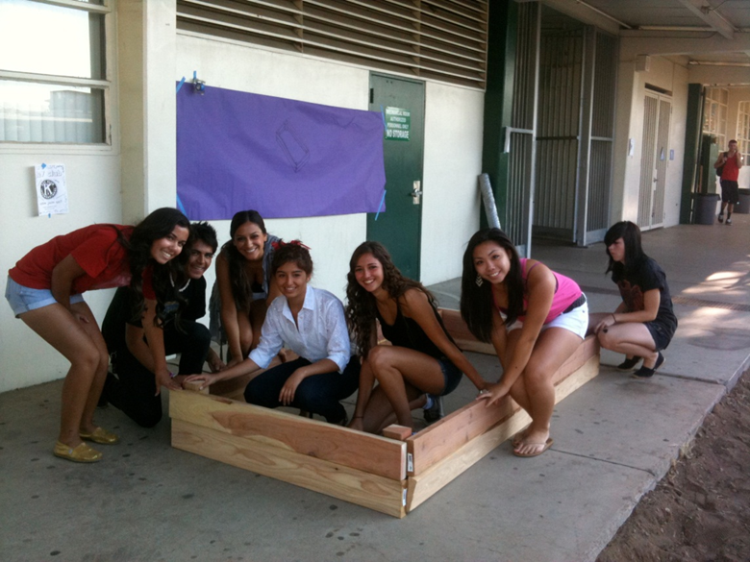
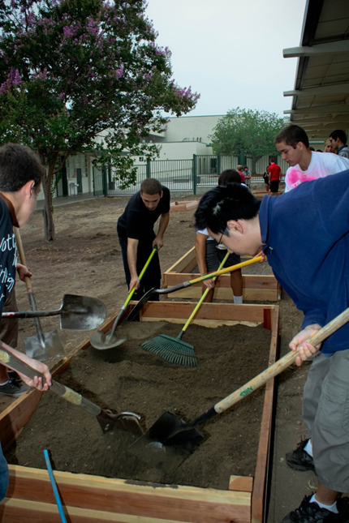
Building Boxes

Slide 16
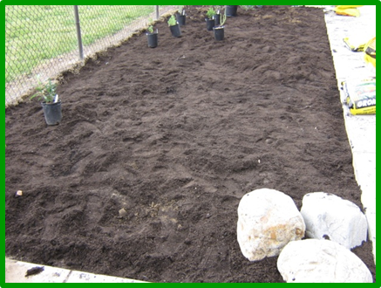
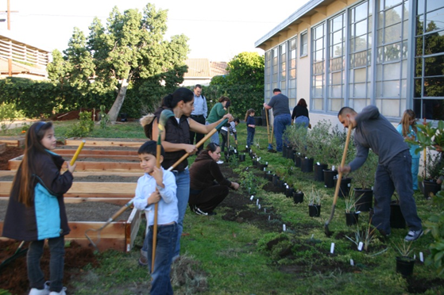
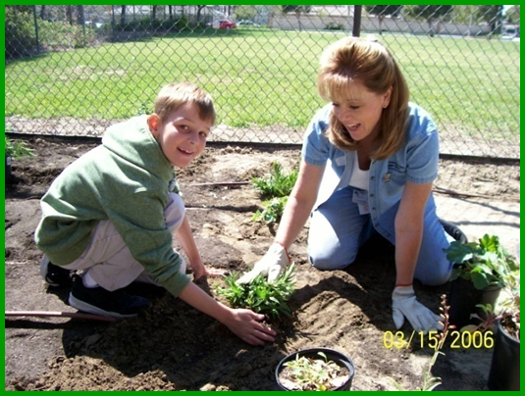
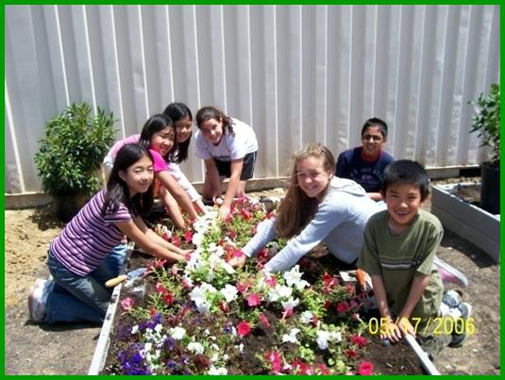
Soil Preparations & Plantings

Slide 17
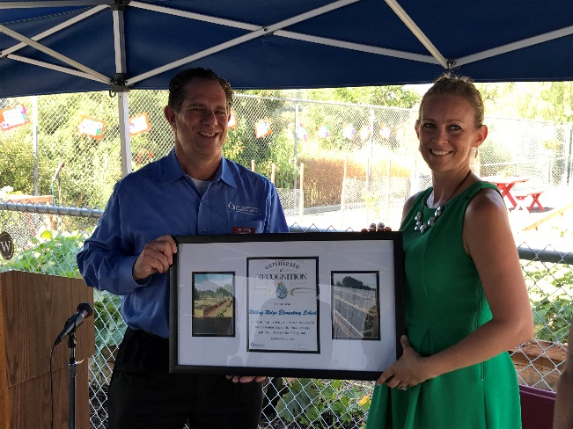
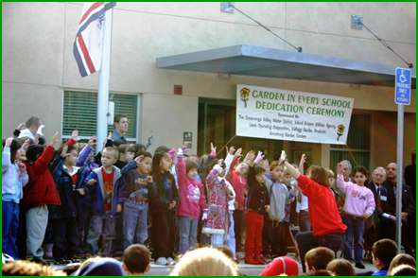
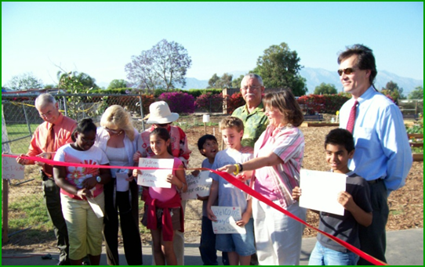
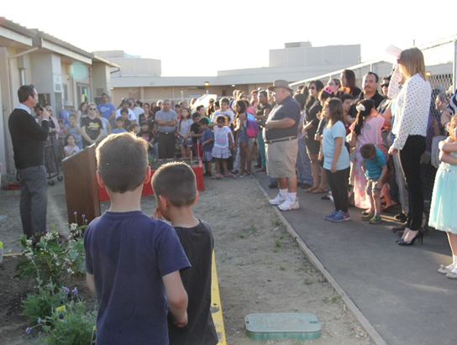
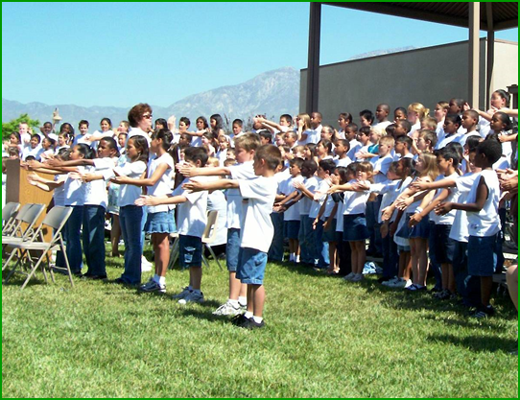
Dedications

Slide 18
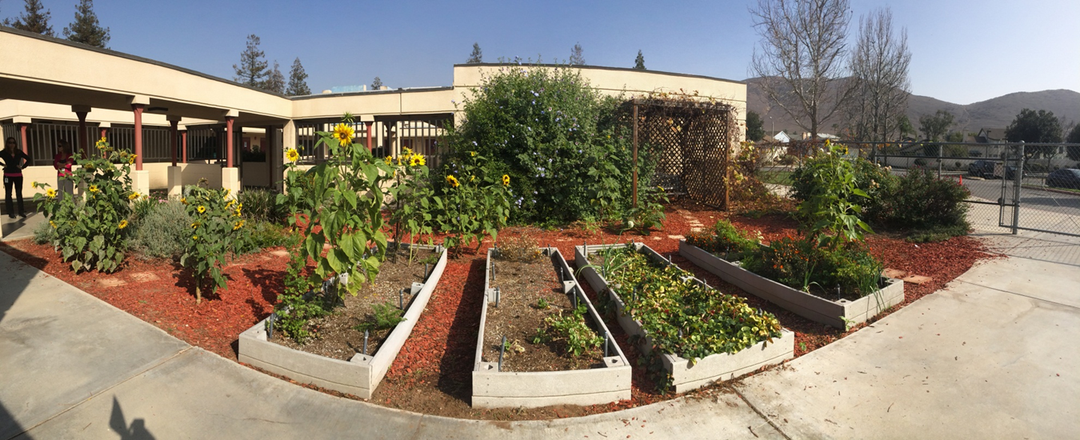
Oak Park Elementary
Fontana

Slide 19
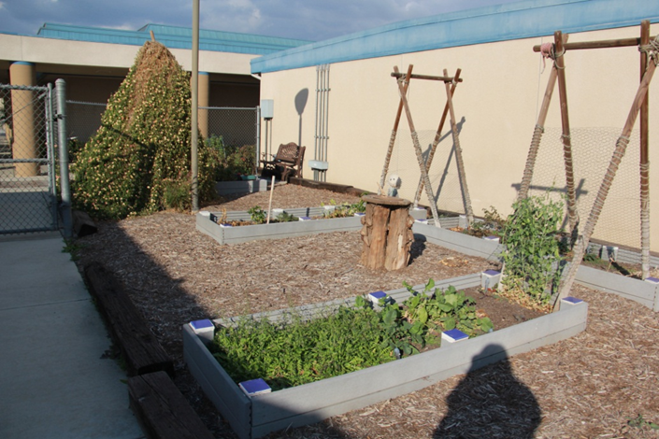
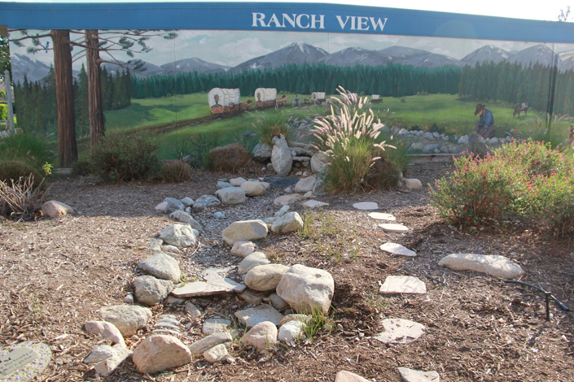
Ranch View
Ontario

Slide 20
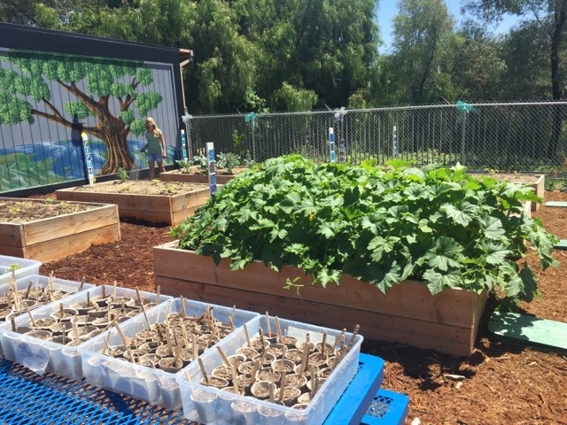
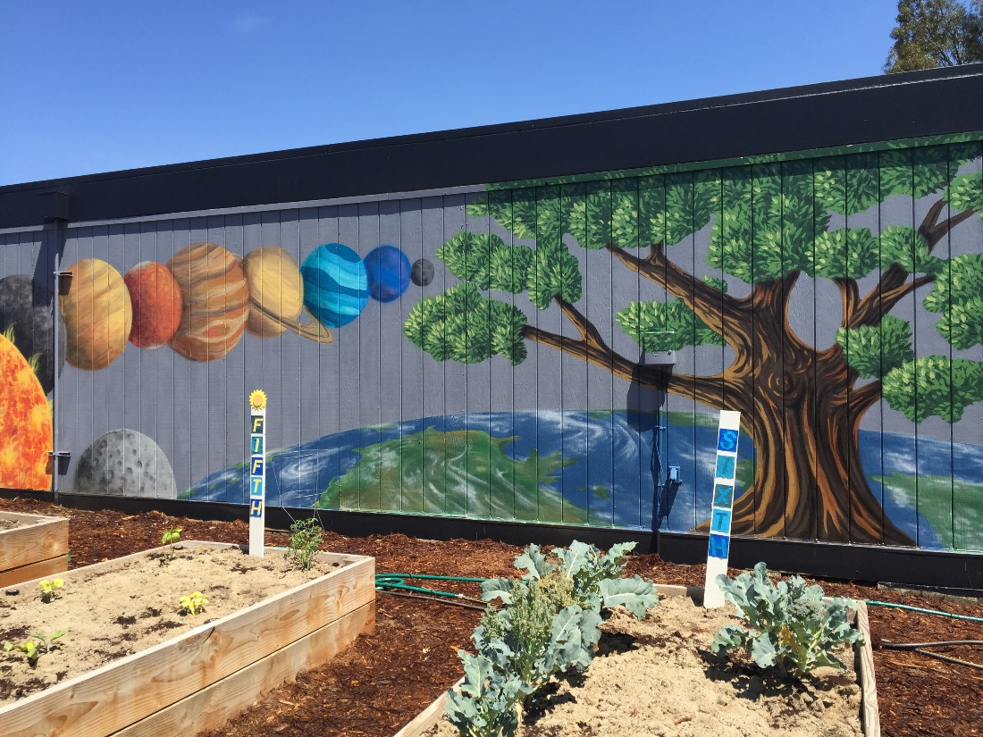
Eagle Canyon
Chino Hills

Slide 21
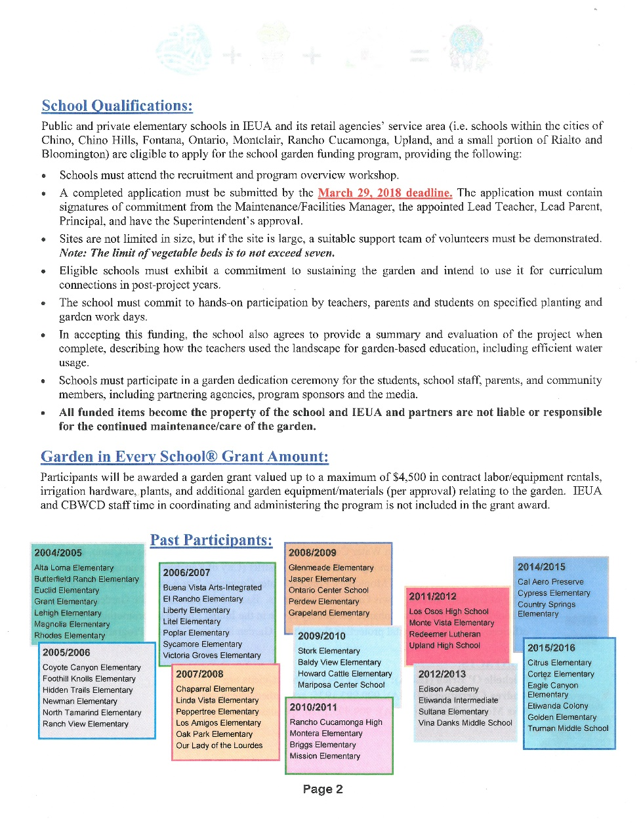
Application Walk-Thru
Deadline: March 29, 2018

Slide 22
Questions

