Slide 1
Water Use Efficiency
Business Plan Update
May 2015

Slide 2
Goals of the Plan
Seek to make long-term changes in customer preferences and the associated markets for target technologies and services
Achieve the highest level of water savings.

Slide 3
Strategy
Build on current programs and scale them to a level at least twice the current regional WUE effort.
Implement a regional Water Infrastructure that will provide programs, technical assistance and support services necessary to achieve market transformation.
Support near term drought response needs in the Inland Empire community.

Slide 4
Active Programs
Premium Toilet Direct Installations 9,665 AF
SoCal Water$mart Rebates 6,850 AF
FreeSprinklerNozzles.com 5,837 AF
HE Nozzle Direct Installations 663 AF
CBWCD Landscape Evaluations 110 AF
Total Active Programs 23,125 AF

Slide 5
Transformative Programs
Home Water Use Reports 5,709 AF
Turf Removal Incentives 4,081 AF
Water Budget Rate Structure* 82,609 AF
*Two agencies implementing
Total Transformative Programs 92,399 AF

Slide 6
Compliance Requirements
Regulatory Agency | Requirement | Approach
Drought | - Reduce 25% Now | -Drought Response
20x2020 | -Reduce GPCD 10% by 2015 -Reduce GPCD 20% by 2020 | -WUE Active Programs Transformative Programs Recycled Water Supply
CUWCC BMPs | -Reduce GPCD 18% by 2018 | Will Align with 20x2020
AB 1420 | -Fulfill BMP Commitments | Thru CUWCC BMP Compliance
SWRCB | - Fulfill State-mandated Drought Targets (varies by retail agency) | Besides meeting state targets, assistance to retail customers reduces customer shortage costs.

Slide 7
IEUA 20x2020 GPCD Goals
 | Baseline GPCD (2001-2010 average) | 2015 Target (10% reduction) | 2020 Target (20% reduction)
Gallons per Capita per Day | 251 | 226 | 201
Projected WUE Activities |  | 5 | 13
Recycled Water Supply |  | 38 | 45
Total |  | 43 | 58
Projected Goal Achievement |  | 208 | 193

Slide 8
Plan Overview
Cost per Acre-foot | $187
Five Year Water Savings | 4,563 acre-feet
Lifetime Water Savings | 14,260
Avoided Costs | $9,707,137
Average Annual Budget | $480,000
Five Year Total Budget | $2,390,000

Slide 9
Plan Components
Current Water Demand and Usage Patterns
Specific Market Opportunities
Strategy for Reaching Water Savings Goals
Recommended Programs
Water savings, costs and benefits
Marketing and operational details
System for Tracking and Reporting Performance

Slide 10
Sector Data - 2013
Customer Type | Number of Accounts | Annual Demand | Percent of Demand
Single-Family | 171,309 | 136,128 | 54.8%
Multi-Family | 7,286 | 26,775 | 10.7%
Commercial | 12,912 | 31,531 | 12.7%
Industrial | 870 | 7,791 | 3.1%
Dedicated Irrigation | 5,332 | 38,326 | 15.4%
Other | 599 | 7,855 | 3.2%
Total | 198,308 | 248,405
Source: PWSS reports

Slide 11
Landscape Use - 2013
Type | % of Sector Demand | % of Total Demand | Acre-feet per Year
Single-Family | 66% | 32% | 73,096
Multi-Family | 42% | 4% | 7,694
Commercial | 57% | 10% | 21,772
Industrial | 71% | 2% | 5,252
Institutional | 94% | 4% | 10,105
Dedicated Irrigation | 100% | 13% | 30,671
Recycled | 100% | 3% | 7,261
Total |  | 69% | 155,850

Slide 12
Lot Size
1,285 Homes Over 1 Acre
468 Homes Over 1.5 Acres

Slide 13
Single Family Toilets
Total Devices 489,331
Remaining (Non Efficient) Devices 121,021
Devices Actively Retrofitted 43,125
Devices Passively Retrofitted 324,931
Saturation 75%
Total Water Savings Potential 5,161 AFY

Slide 14
Single Family Clothes Washers
Total Devices 151,693
Remaining (Non Efficient) Devices 135,610
Devices Actively Retrofitted 10,618
Devices Passively Retrofitted 5,465
Saturation 11%
Total Water Savings Potential 2,116 AFY

Slide 15
Multi-Family Toilets
Total Devices 103,722
Remaining (Non Efficient) Devices 12,582
Devices Actively Retrofitted 29,206
Devices Passively Retrofitted 61,934
Saturation 88%
Total Water Savings Potential 660 AFY

Slide 16
Multi-Family Clothes Washers
Total Devices 13,484
Remaining (Non Efficient) Devices 12,849
Devices Passively Retrofitted 635
Saturation 5%
Total Water Savings Potential 201 AFY

Slide 17
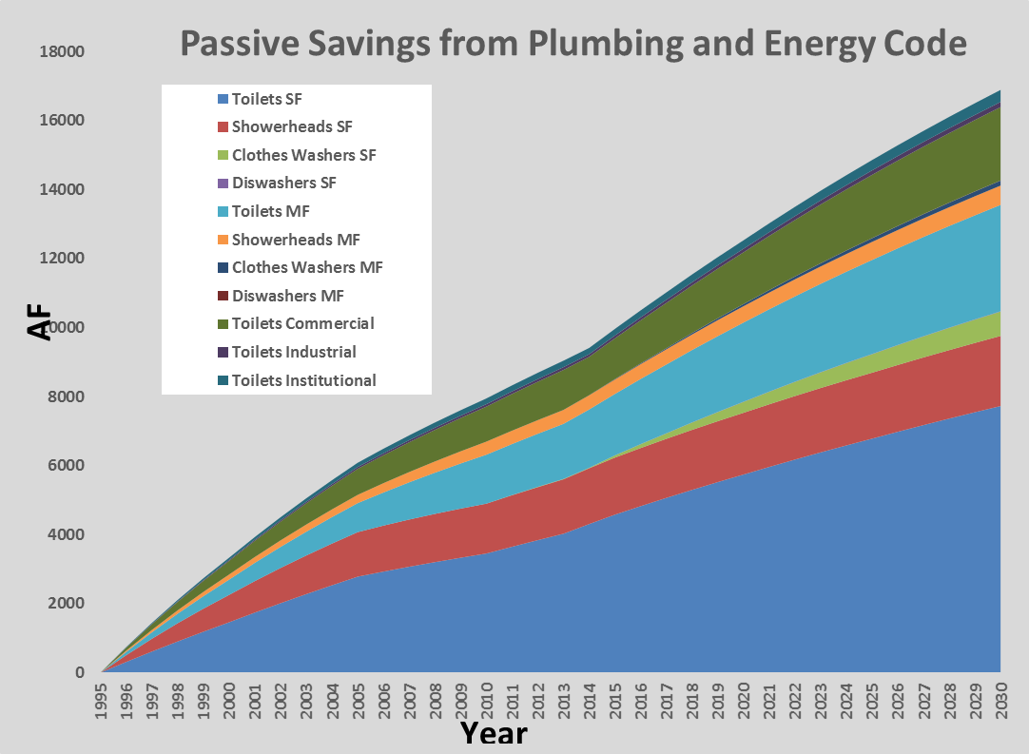
Passive Savings 12,528 AF by 2020
}
Additional since 2013
(account in LT Demand Forecast)
Notes:
Source: IEUA_AWETrackingTool_v3CalTexEditionbeta1_RetrospectiveSAVINGSONLY_2015_04_07.xlsm Worksheet: PlumbCodeAdjustments

